Slide 1
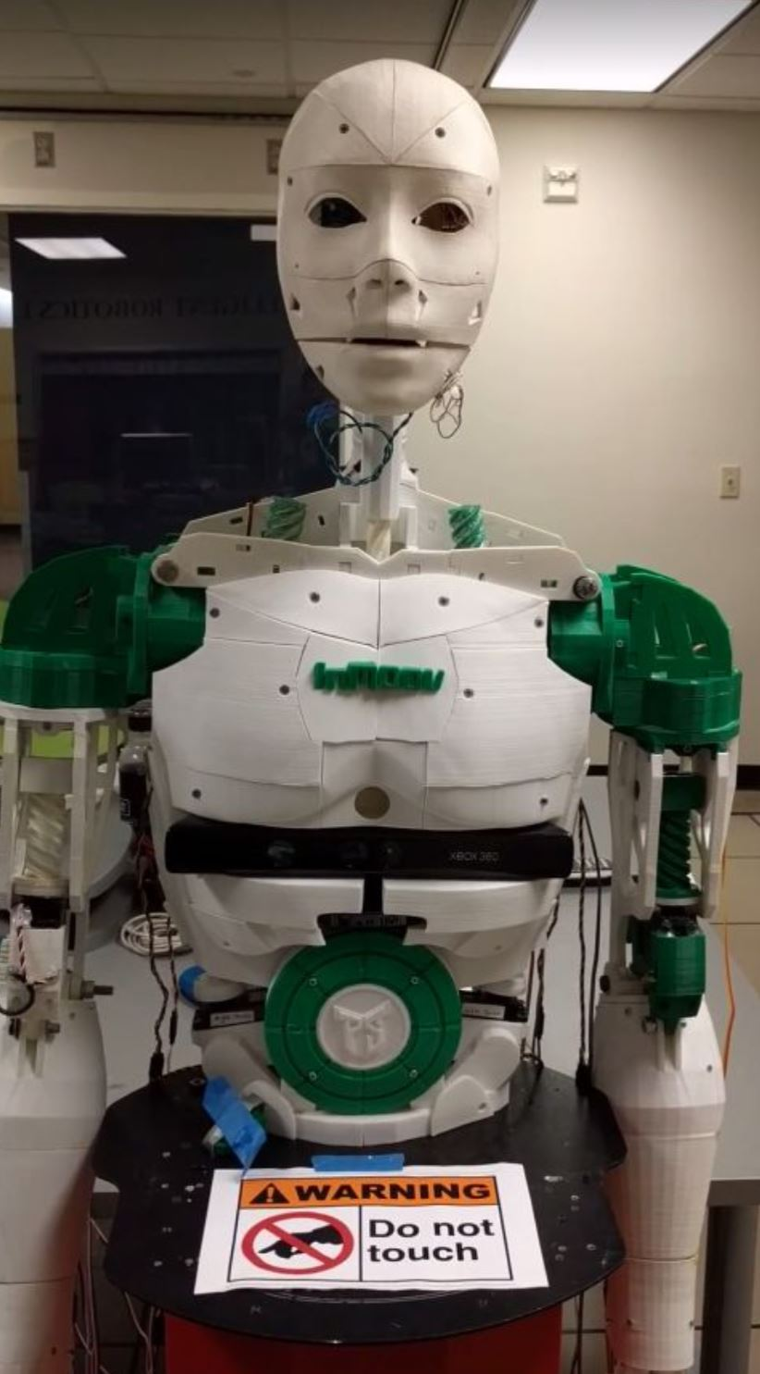
Bohr Inmoov Team
Meshal Albaiz
Tristan Cunderla
Brian Henson
Danielle Nicholas
Aron Schwartz

Slide 2
Project Description
Resurrect InMoov robot and Pioneer base
Fix mechanical issues with InMoov robot
Fix issues with Pioneer base
Supply InMoov with servo HATs
Test all servos
Create pose maker, saver, and executer
Explore ROS for Raspberry Pi

Slide 3
Project Tasks and Progress
Locate robot ✔️
Resurrect the robot to its “original” functionality (Fall 2017/Winter 2018) ✔️
Mechanical assessment ✔️
Assess material, strength, servo control, power solutions ✔️
Replace components, improve the “links”, etc ✔️
Pioneer mobile base and Torso power solution ✔️
User power supply from base to power upper body servos ✔️
Create “natural” gestures for both InMoov arms and torso ✔️
Basic cable management ✔️
Notes:
Aron

Slide 4
Project Tasks and Progress
Replaced failed Pioneer batteries & developed power distribution circuitry ✔️
12V batteries to 5V PWM hat supply using linear voltage regulator chips
Restructuring/upgrades in InMoov driver code ✔️
Copied interpolation/threading solution from last term’s robot ✔️
Not immensely useful because the servos are already quite slow, but it could come in handy
Ordered & assembled new servo HATs ✔️
Better test system for calibrating servos ✔️
Re-assess/re-calibrate joints & servos ✔️
Tested built-in self test movement for Pioneer mobile base ✔️
Notes:
Tristan

Slide 5
Project Tasks and Progress
Created a program that allows full-body posing, to help with animation building ✔️
Tested power distribution circuitry, to both Pioneer and InMoov ✔️
Get a NUC to control the Pioneer and explore SLAM X
Used Raspberry Pi to control the Pioneer base without SLAM ✔️
Used ROS to communicate between the two Raspberry Pis ✔️
Fixed mechanical issues (worm gears, got replacement parts, found better screws, etc) ✔️
Notes:
Meshal

Slide 6
Robot Mechanical Updates
The left shoulder was replaced with parts from the extra arm that was found in the lab.
The Pioneer base had its chassis lifted by an inch with header screws in order to allow for access to the serial port.

Slide 7
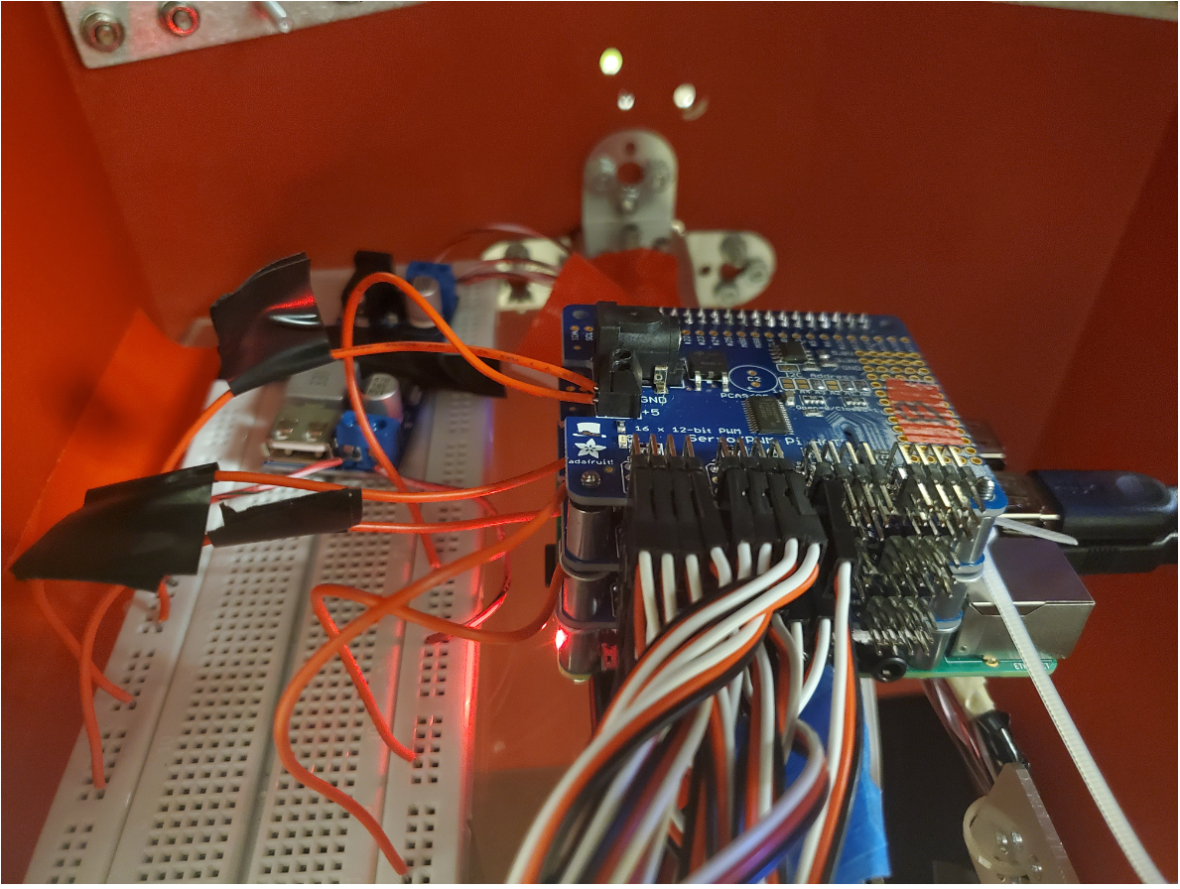
Updated Power Solution
Original solution: Three Parallel 12 volt supplies
One from each battery
Fed into 1.5 AMP regulator
This solution was flawed however, as the three lines are parallel.
New solution: Combined all three 12 volt lines and fed Into 5 amp voltage regulator
Handles Voltage Step Down
Handles Current Requirements
Three servo hats and Raspberry Pi utilize 5 volt output from the regulator.
Also allows battery recharging through the Pioneer Base

Slide 8
Robot Drivers
Inmoov.py defines Inmoov class, reads inmoov_servo.json file and builds a servo object for each entry
It builds a hierarchy of objects from these servo objects, where the finger servo is part of a Finger object, which is in turn part of a Hand object, which is part of an Arm object, etc…
Servo.py defines a Servo class, represents one servo in the bot
It holds config values such as the angle-space limits, the PWM-space values that correspond to those endpoints, the PWM hat # and channel #
Pwm_Interface.py serves as the interface between the code that the group wrote with the drivers that control the Adafruit HATs
It is where the order (bottom-middle-top) of the servo hats is correlated to their addresses (0x4A-0x4C-0x4B)

Slide 9
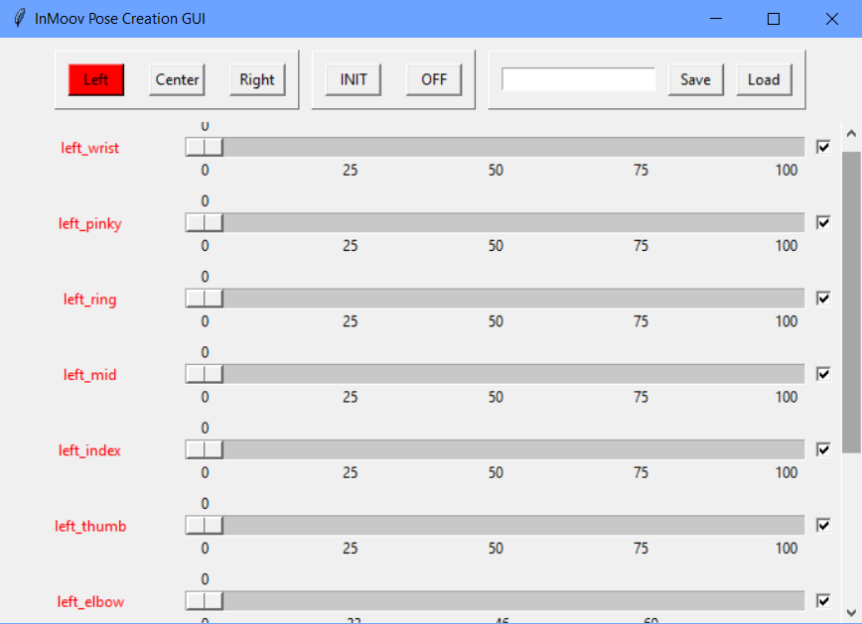
Body Poser GUI
Used to set every servo on the InMoov torso to create a pose
Servos can be turned on/off and included/excluded from the pose
Poses can be saved to a JSON file
Poses can be used to make animations using the Animation Creator GUI

Slide 10
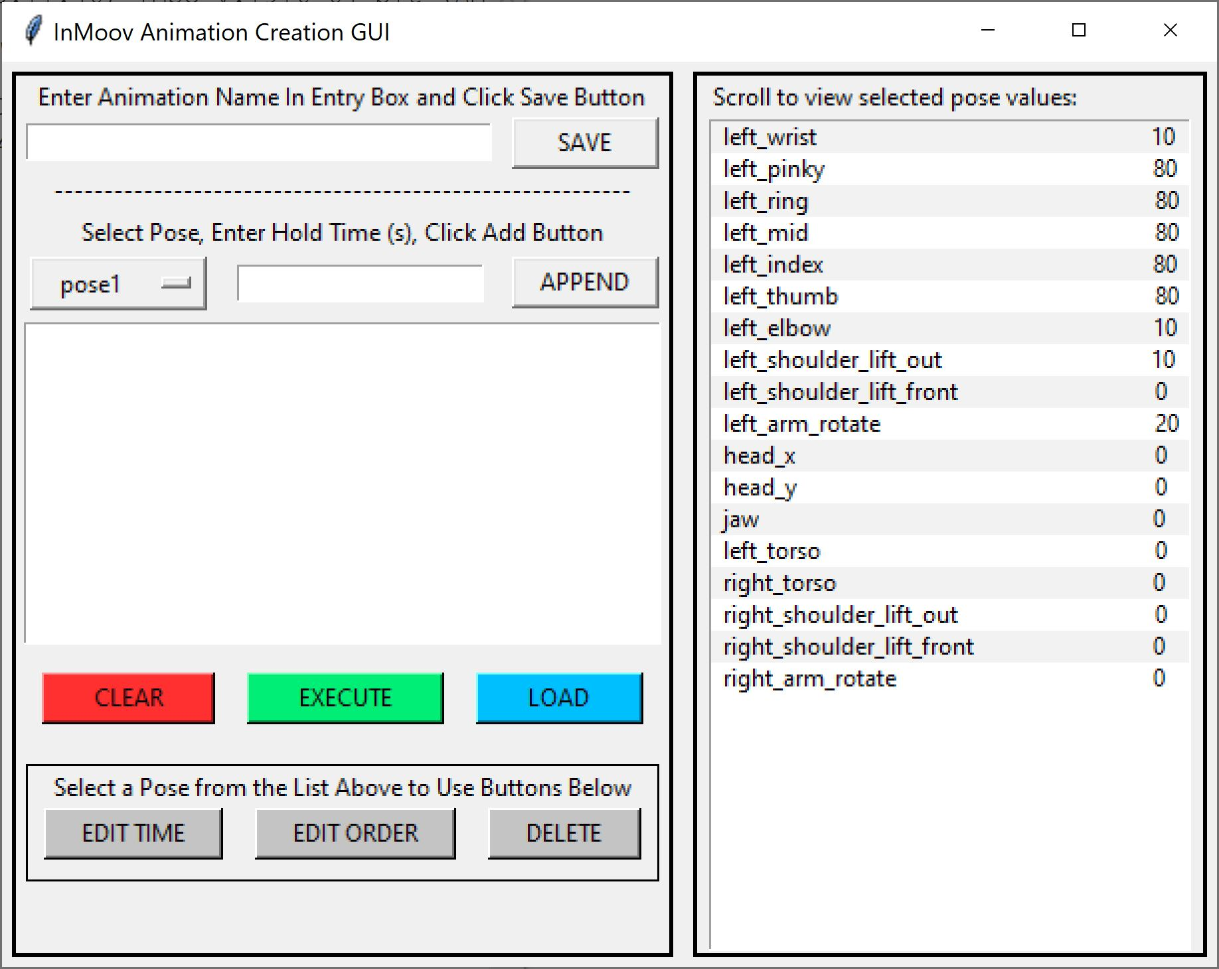
Animation Creator GUI
Animations created using static poses with time delays in between
Created using Tkinter
Create and save animations for Inmoov robot
Run animations from GUI
Delete poses from animations
Edit pose hold time and position within animation

Slide 11
ROS
Designed to communicate between Raspberry Pis and control Pioneer base
Can be used to:
Launch GUIs from another Pi
Transfer image from Pi camera on another Pi
Control the InMoov robot from another Pi
Transfer files between Pis
View live feed of Pi camera
Control the Pioneer base using RosAria

Slide 12
Project Challenges
NUC Issues
Pioneer control board NUC has SATA drive issues, haven’t been able to explore using SLAM algorithms on the Pioneer bot
Unable to use Pioneer bot to its full potential
Servo Control Issues
Twitchy Forearm
“Drift” Effects
Often challenging to pinpoint (power, control, I2C, all three, etc)
Physical Issues
Breaking Plastic and Encoders
Lots of hot glue, “improvised” mechanical solutions required
Notes:
Brian

Slide 13
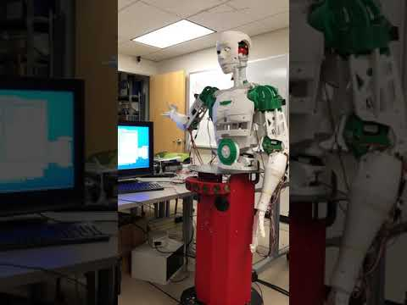
Video Demo - Wave and Handshake

